Slide 1
Member’s name(Business Projects (1))
Title
【Description】
~~~
~~~
~~~
Picture
【Factors for Success】
~~~
~~~

Slide 2
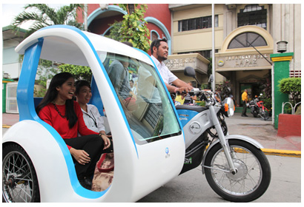
JAPAN(Business Projects (1))
Enabling Entry into Taxi Business by Remote Control using IoT (Company A)
【Description】
This business project facilitates low-income people in starting a taxi business by giving a loan without collateral for purchasing a taxi vehicle.
IoT technology enables a creditor to locate and cease operation of a purchased taxi remotely, thereby reducing the risk of unrecoverable loans.
The project is ongoing in the Philippines, Cambodia, and Indonesia.
【Factors for Success】
IoT technology enables creditors to give loans without collateral.
The project meets the need of people who have the will and ability to start their own business but do not have sufficient collateral.

Slide 3
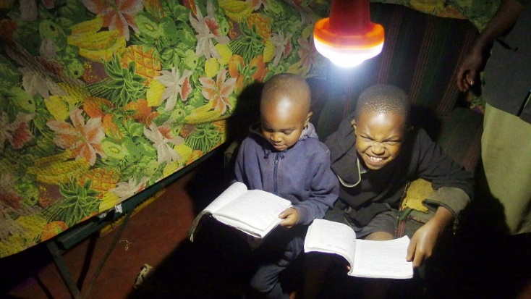
JAPAN(Business Projects (2))
Power Supply to Off-the-grid Areas in Africa (Company B)
【Description】
Company B puts in place solar panels at kiosks located in off-the-grid villages in Africa and provides charging services.
Company B also creates demand for local electricity and achieves increases in sales of charging services with its rental service of LED lanterns and of equipment associated with charging.
Users can have access to the use of LED lanterns and other electric equipment without grid extension.
Company B
Kiosk
End user
【Factors for Success】
This project involves no cost associated with the construction of infrastructure for power plans and grids.
Selling electricity according to the demand of each customer allows low-income people to utilize charging services.
Renewable energy created by solar panels is also eco-friendly.

Slide 4
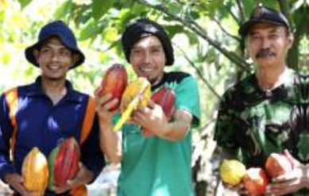
JAPAN(Business Projects (3))
Improving quality of cacao beans and cultivating demand for quality beans (Company C)
【Description】
Company C instructs cacao-bean farmers in Indonesia on fermentation technology , and raises their income with fermented cacao beans.
Company C can ensure the supply of quality cacao beans; also, consumers come to enjoy products made from quality cacao beans.
Company C encourages cacao-bean farmers to plant a different crop
in their cacao farm to increase their income and to stop slash-and-burn
agriculture.
【Factors for Success】
This project improves the quality of cacao beans, and succeeds in setting an appropriate price for them.
This project makes a success in establishing its products as qualified chocolate made by raw cacao beans.

Slide 5
Member’s name(Policies (1) )
Title
【Description】
~~~
~~~
~~~
Picture
Application Example
~~~
~~~.
【Policy Effect】
~~~
~~~
~~~

Slide 6
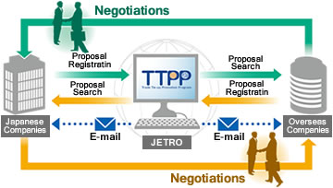
JAPAN(Policies (1))
Trade Tie-up Promotion Program (JETRO)
【Description】
Trade Tie-up Promotion Program (TTPP) is an international business matching system operated by the Japan External Trade Organization (JETRO).
The TTPP provides proposal information related to various types of businesses ranging from import and export to business tie-up and business support. Business proposals registered by foreign users are translated into Japanese to enable Japanese users to view them both in English and Japanese.
Registered business proposals and users (business entities) can deliver their business information to business people around the world through TTPP's Japanese and English website, enhancing their business opportunities. Users can provide their information in a timely way since they can register, update or delete their business proposals on the TTPP website at any time.
【Policy Effect】
Possibility of enhancing innovative solutions to meet the SDGs may increase by increasing international business transactions.

Slide 7
JAPAN(Policies (2))
Program for Promoting Innovative Activities by People from Abroad (City X)
【Description】
This program grants status of residence for six months to people from abroad who start a business in City X.
The scope of this program is included but not limited to the following:
Sectors which require creativity (e.g. semiconductor, robotics)
Sectors related to health, medical, and welfare (e.g. development of regenerative medicines and medical devices)
Sectors related to the environment and energy (e.g. development of clean energy, next-generation storage battery, and GIS)
Application Example
Dr. A in Singapore established an office which develops and sells equipment to improve the quality of sleep by utilizing this program.
【Policy Effect】
Possibility of innovative solutions to meet the SDGs may increase by facilitating the use of technologies and ideas brought by foreign entrepreneurs.

Slide 8
Timeline for Publication
End of March Contributions due for Initial Submission
April 10th-11th Discussion at TIWG2
June 8th-9th Publication at the Ministerial Meeting
Note:
Although the names of projects and companies included in this document are made anonymous, the final publication is expected to be made public with the real names of projects and policies in non-anonymous form.
Contact for Submission
Mitsutoshi Oriyama, Trade Policy Bureau, METI (oriyama-mitsutoshi@meti.go.jp)
Naoki Kobayashi, Trade Policy Bureau, METI (kobayashi-naoki@meti.go.jp)
Daisuke Shamoto, Trade Policy Bureau, METI (shamoto-daisuke@meti.go.jp)

